Slide 1
Action tags in JSP
The following are the action tags available in JSP
jsp:include
jsp:forward
jsp:usebean
jsp:setProperty
jsp:getProperty
jsp:fallback
jsp:element
jsp:body
jsp:text
jsp:attribute
jsp:param
jsp:plugin
  The highlighted ones will be covered in detail in the coming slides.

Slide 2

JSP:include
Used for dynamically including the pages
Includes the output of the included page during run time
Contents of the page are not included – Only the response is included.
Assume footer.jsp is included homepage.jsp
R
E
Q
U
E
S
T
R
E
S
P
O
N
S
E
5
The footer JSP response is included in the home page and response sent to client.
2
1
Home page translated to homepage.java by web container.
4
homepage.jsp
homePage_jsp.java
footer_jsp.java
3
Home page requests footer JSP file.

Slide 3
Jsp:include tag
Syntax :
<jsp:include page=“PageName” />
Example : Assume that the following line is included in index.jsp
<jsp:include page=“myPage.jsp” />
Here the myPage.jsp response is included in the index.jsp

Slide 4
Directive Vs Action include
Consider a scenario in which we are asked to create a login application . They have the following requirements
Home page is common for all categories of employees
The heading is different for different designation of employees and should be included in all the pages based on the employee designation
The footer page is common for all and should be include in all the pages .
Given the above scenario,
What is the include mechanism you will use to include the heading page ?
What is the include mechanism you will use to include the footer ?

Slide 5
Difference between directive and action include
Manager Request Login
Login.jsp
Login success. User redirected to home page
Few observations:
When Trainee logs into the application the Trainee Heading JSP will be included in the Home page.jsp.
So all dynamic pages can be included using action include.
For including static pages use directive include which happens only once during the translation phase.
footer.html
To be included using directive include
Home.jsp (with footer.html)
+
managerHeading.jsp
home.jsp
Home_java.jsp
During the first request the page is translated into a servlet .The files included using directive include gets included at this translation stage.
Includes managerHeading.jp since manager has logged in
managerHeading.jsp
traineeHeading.jsp
To be included dynamically based on the employee designation

Slide 6
jsp:forward
The forward action tag is used to transfer control to a static or dynamic resource.
The forward action terminates the action of the current page and forwards the request to another resource such as a static page, another JSP page, or a Java servlet.
The static or dynamic resource to which control has to be transferred is represented as a URL.
The user can have the target file as an HTML file, another JSP file, or a servlet.

Slide 7
jsp:forward Syntax
Syntax:
<jsp:forward page=“URL" />
Forwards the request to the specified URL.
Example :
<jsp:forward page=“success.jsp" />
Forwards the request to the success.jsp
When used?
Provides the same functionality of the forward() method inRequestDispatcher interface
Used for forwarding request from one JSP to another .

Slide 8
jsp:Param
The jsp:param action is used to add the specific parameter to current request.
The jsp:param tag can be used inside a jsp:include (or) jsp:forward.
Syntax:
<jsp:forward page =“URL" />
<jsp:param name =“paramName” value="parameterValue”/>
</jsp:forward>
<jsp:include page =“URL" />
<jsp:param name =“paramName“ value="parameterValue”/>
</jsp:include>

Slide 9
jsp:Param Example
A Scenario: Consider a scenario on successful login the user needs to be forwarded to the success page with the user name set as an parameter to the request object so that name can be accessed in the home page and displayed.
Jsp:Param can be used along with jsp:Forward as shown
<jsp:forward page =“success.jsp" />
<jsp:param name =“userName” value=“<name>”/>
</jsp:forward>
Where
success.jsp : success page
userName : Request attribute Name
name : The variable containing the user’s name

Slide 10
jsp:useBean
The <jsp:useBean> tag attempts to locates a bean or if the Bean does not exist, instantiates it from the class specified.
Syntax: <jsp:useBean id="name" class="package.class“ scope=“request/session/page/application“ />
Where ,
Id – The name used for referring for the bean object
Class – The Bean Class
Scope - The scope in which the bean object is available

Slide 11
Other Attributes for useBean action tag
Attribute | Description
id | Gives a name to the variable that will reference the bean. A previous bean object is used instead of instantiating a new one if one can be found with the same id and scope.
class | Instantiates a Bean from a class, using the new keyword and the class constructor. The class must not be abstract and must have a public, no-argument constructor. The package and class name are case sensitive.
scope | scope="page|request|session|application" Defines a scope in which the bean exists .The default value is page.
type | If the Bean already exists in the scope, gives the Bean a data type other than the class from which it was instantiated. If you use type without class or beanName, no Bean is instantiated. The package and class name are case sensitive.
beanName | Gives the name of the bean, as you would supply it to the instantiate method of Beans.

Slide 12
How jsp:useBean works?
Example : <jsp:useBean id=“user" class=“com.catp.beans.UserBean“ scope=“request “ />
How it works? Sequence of steps,
Attempts to locate a Bean with the name “UserBean” in the request scope.
If it finds the Bean, stores a reference in the variable user.
If it does not find the Bean, instantiates a bean using the class UserBean, and stores the reference to the variable user.

Slide 13
Bean Object Scopes
page :is available only within the JSP page and is destroyed when the page has finished generating its output for the request.
request : valid for the current request and is destroyed when the response is sent
session : valid for a user session and is destroyed when the session is destroyed
application : valid throughout the application and is destroyed when the web application is destroyed/uninstalled.

Slide 14
jsp:setProperty
The setProperty action sets the properties of a Bean. The Bean must have been previously defined before this action.
Syntax:
<jsp:useBean id="myName" class=“package.class” />
<jsp:setProperty name="myName" property="someProperty” value =“someValue” />
Where,
name : the name of the bean object and should be the same as the id value specified in usebean
property :the bean property (field name) for which the value is to be set. There should be a instance variable with the property name specified and accessors/mutator methods.
value : the value to be set for the property .

Slide 15
jsp:setProperty mapping HTML forms
The following options can be used to automatically set the values from an HTML form to a java bean using the setProperty action.
Option 1
<jsp:setProperty name=“UserBean" property="someProperty” param =“userName” />
Sets the value of the HTML form element with the name userName into the bean UserBean’s property someProperty.
Option 2
<jsp:setProperty name="myName" property="*” />
Sets all the values of the form elements into the bean properties.
In this case the name of the property and the name of the form element should be the same

Slide 16
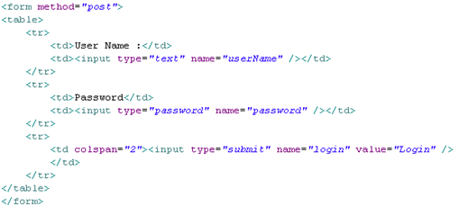
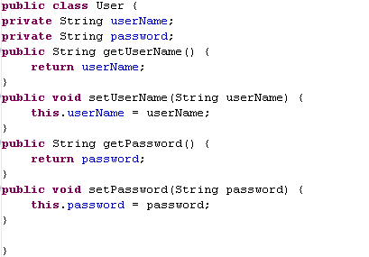
Example for jsp.setProperty usage
HTML form
UserBean
Option 1:
<jsp:useBean id=“user” class=“com.catp.beans.User”/>
<jsp:setProperty name=“user” property=“userName” param=“userName”/>
<jsp:setProperty name=“user” property=“password” param=“password”/>
Option 2:
<jsp:useBean id=“user” class=“User”/>
<jsp:setProperty name=“user” property=“*”/>

Slide 17
jsp:getProperty
The getProperty action is used to retrieve the value of a given property and converts it to a string, and finally inserts it into the output.
Syntax:
<jsp:useBean id=“myName” type=“package.class” />
<jsp:getProperty name="myName" property="someProperty" />
Where,
name : Bean name same as the id specified in the usebean action
property : The bean property name whose value is to be retrieved

Slide 18
jsp:getProperty Example
Example:
<jsp:useBean id=“user” type=“com.catp.beans.UserBean” />
<jsp:getProperty name=“user" property=“userName" />
This Reads the value of the property named userName from the UserBean and prints it

Slide 19
Recap: JSP Action tags
JSP Action tags | Description
jsp:include | For including a page dynamically in a parent page.
jsp:forward | For forwarding the request to a another resource.
jsp:usebean | To reference a bean and use its properties.
jsp:setProperty | Set the value of a property referred using use bean.
jsp:getProperty | Gets the property value of a bean referred in use bean tag.
jsp:Param | Used to share parameter and its value with the page being included or forwarded.

Slide 20

Time To Reflect
Associates to quickly summarize the following before ending the session
What is a java bean?
What is the difference between action and directive include?
What is the action tag used for setting a beans property value?
What is the action tag used for forwarding the request?
What is the action tag used for including a page?
What is the action tag used for mapping HTML form elements with the bean.?

Slide 21
Lend a Hand : Action Tags
Using this demo the associates gets familiarized with the following action tags in JSP
jsp:include
jsp:param
jsp:useBean
jsp:setProperty
jsp:getProperty
jsp:forward

Slide 22
Lend a Hand - Requirement
Consider a scenario in which ABC Soft corp have approached you to create a registration form for their Employees for maintaining profile of each employee in the company.
The requirement is as slated below
There are three designation of employees
Manager
Developer
Trainee
Employees should enter details in the registration form
On successful entry the employee is forwarded to their respective home pages.

Slide 23
Lend a Hand- Requirement (Cont)
The heading of the home page will be based on the designation of the employee.
The heading should be dynamically loaded based on designation of employee.
A welcome message should be present in the home page.
Components
Registration.jsp : Registration page used by employees to register.
Success.jsp : Common Home page for all employees.
traineesHeading.jsp : Heading page for trainee’s success page.
developersHeading.jsp : Heading page for developer’s success page.
managersHeading.jsp : Heading page for manager’s success page.
Employee.java : The java bean class for storing the employee details.

Slide 24
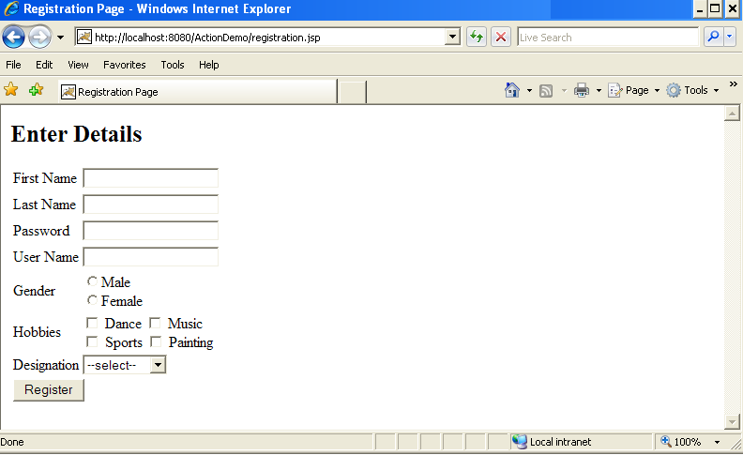
Lend a Hand : Registration page Design
Create registration page as shown below
Should have three values Manager, Trainees, Developer.

Slide 25
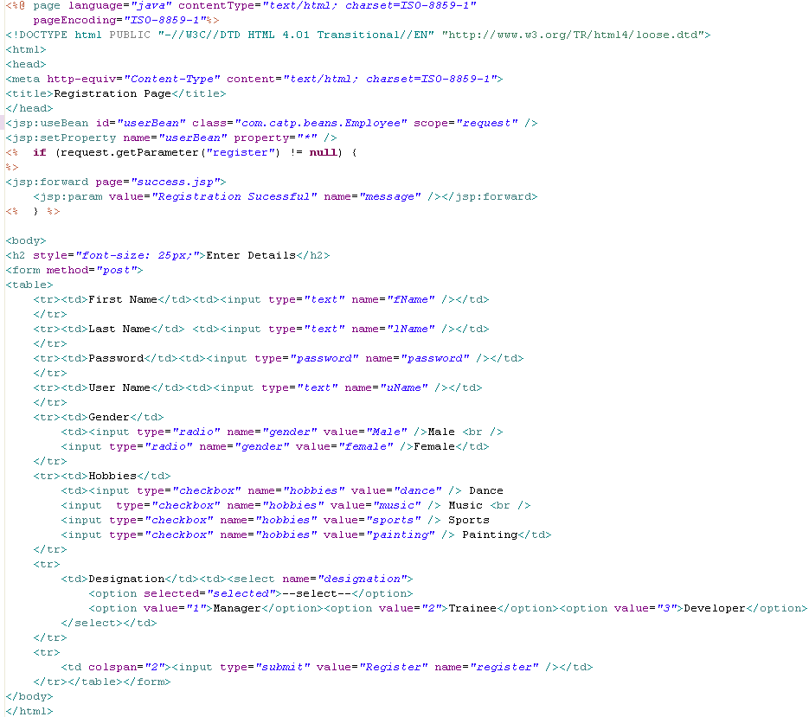
Lend a Hand : Registration.jsp code
Instantiates bean using useBean action and sets the value using setProperty action.
IMPORTANT: Ensure the name of the form elements are same as the bean property names. They are case sensitive.
Use JSP:forward to forward request to success page and jsp:param to set success message.

Slide 26
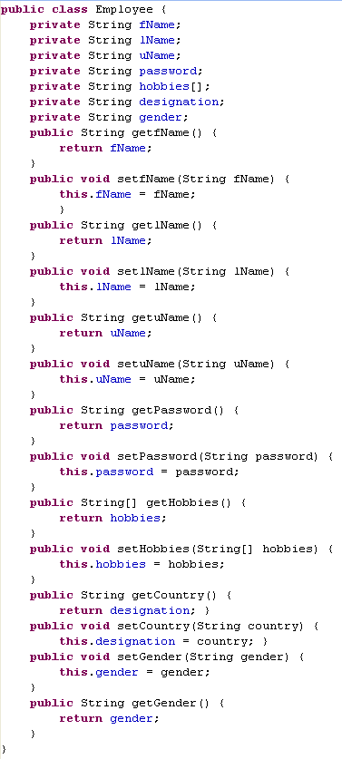
Lend a Hand – Develop User Bean

Slide 27
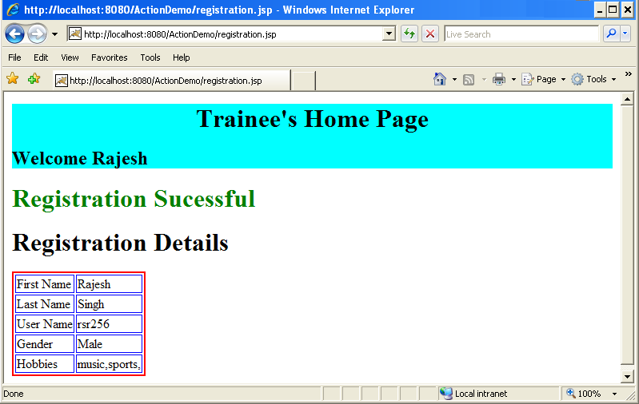
Lend a Hand- Success page Design
Create a success page which includes the header page.
The header page should be included based on the designation selected. Say “Manager Home Page”, Trainee Home Page” (or) “Developer Home Page”
The body of the success page should display all the details which the user entered in registration page in a tabular format

Slide 28
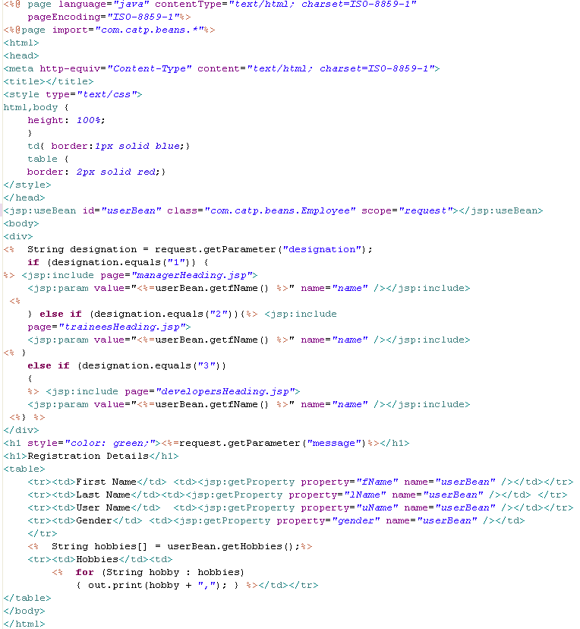
Lend a Hand - Develop success.jsp
Use JSP:include to include the respective pages and use jsp:param to set name value as a parameter for heading page to display.
Reads the value using getProperty action and prints it.

Slide 29
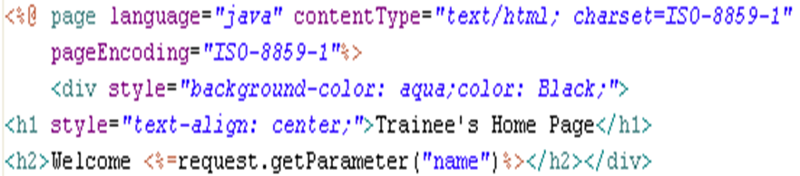
Lend a Hand – Develop traineesHeading.jsp
Access the parameter set and print the message.

Slide 30
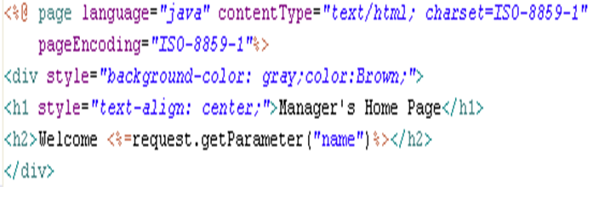
Lend a Hand – Develop managersHeading.jsp

Slide 31
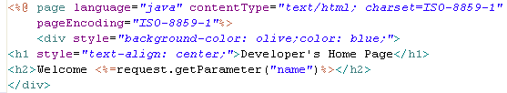
Lend a Hand – Develop developersHeading.jsp

Slide 32
Lend a Hand – Deploy and Run
Step 1 : Deploy and run the application
Step 2 : Invoke the registration.jsp from the browser
http://localhost:8080/ActionDemo/registration.jsp
Step 3 : Enter the registration details, designation as manager and click register.
Step 4 : The success page should be displayed with the manager header.
Continue step 3 and for 4 for Developer and Trainee designation. The screen should display the appropriate header pages.

